Slide 1

AI-Powered FDA Document Intelligence System
Using RAG (Retrieval Augmented Generation) for Smarter Compliance
Prepared by: Mohit

Slide 2


CURRENT STATE
The Compliance Documentation Challenge
Regulatory teams face mounting pressure managing vast volumes of FDA documentation. Manual processes create bottlenecks that compromise efficiency and increase risk exposure.
Volume Overload
Hundreds of FDA PDF reports require systematic review and analysis
Time-Intensive Searches
Manual document searches consume hours of valuable expert time
Tracking Complexity
Observations and CAPA management lack centralised oversight
Critical Risk
Key compliance issues can be overlooked in document review processes

Slide 3
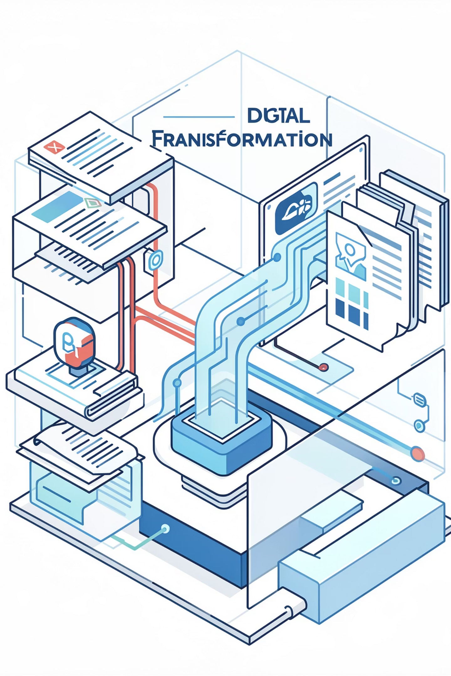
SOLUTION
Transforming Document Intelligence
This intelligent system eliminates manual bottlenecks whilst delivering precise, verified answers from your regulatory documentation in seconds.
Instant Insights
Zero Manual Reading
Verified Accuracy
Retrieve answers from documents immediately without manual searching
Factual outputs sourced directly from your documents
AI processes entire document libraries on your behalf
Unified Intelligence
One centralised system for all regulatory queries

Slide 4


TECHNOLOGY
The RAG Architecture Advantage
Retrieval Augmented Generation combines the power of intelligent search with advanced AI language models. This hybrid approach ensures responses are grounded in your actual documents, not generic AI knowledge.
Multi-Format Support
Natural Language Queries
Upload PDFs, Excel files, and scanned documents seamlessly
Ask questions in plain English—no technical syntax required
Intelligent Retrieval
Precise Answers
AI searches across your entire document library contextually
Responses extracted directly from relevant source material
Example query: "Show me all repeated FDA observations from the last three inspections related to equipment qualification"

Slide 5

HOW IT WORKS
RAG Technology Simplified
Understanding the intelligent process behind accurate document retrieval and response generation.
Vector Search
Retrieve relevant content quickly
Answer Generation
Upload & Index
Add documents and create vectors
AI composes accurate responses
Unlike traditional AI that guesses answers, RAG finds the relevant text first, then constructs responses based exclusively on that verified content—ensuring factual accuracy and eliminating hallucinations.
Retrieval First
Context-Aware
Source-Grounded
Identifies relevant document sections using semantic search
Understands relationships between regulatory concepts
Every answer includes document references for verification

Slide 6
PROCESS
End-to-End System Workflow
01
02
Document Upload
Intelligent Extraction
Users upload FDA reports, inspection documents, and compliance files to the secure platform
Advanced OCR and text processing extract content from PDFs, including scanned documents
03
04
Vector Indexing
Natural Query
Content is processed into semantic embeddings and stored in an optimised vector database
Compliance officers ask questions in plain English through an intuitive interface
05
06
Smart Retrieval
Verified Response
System identifies and retrieves the most relevant document sections based on semantic meaning
AI generates accurate answers with source citations, enabling immediate verification

Slide 7
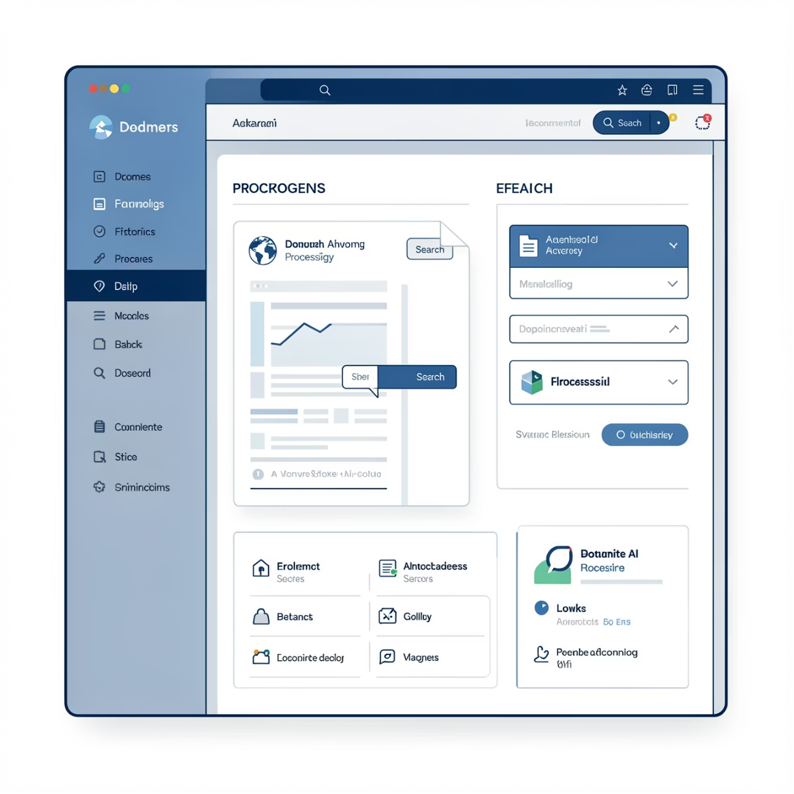
CAPABILITIES
Comprehensive Technical Features
Built for the demanding requirements of regulated industries, combining cutting-edge AI with practical usability.
Universal Document Support
Processes scanned PDFs, digital documents, and spreadsheets with equal accuracy
Batch Processing
Handle multiple files simultaneously for efficient library building
Rapid Search Performance
Sub-second query responses across thousands of pages
Precision Accuracy
Source-verified responses with document references
Intuitive Interface
No technical expertise required—designed for compliance professionals

Slide 8

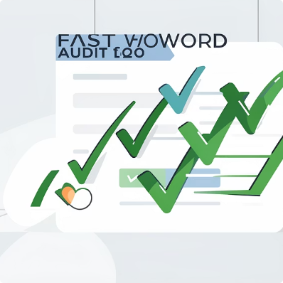
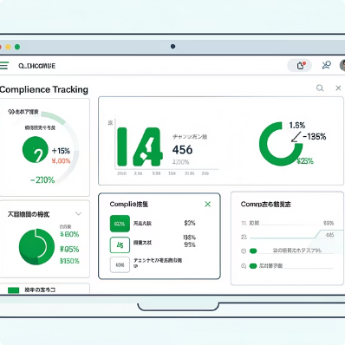


BUSINESS IMPACT
Measurable Operational Benefits
Transform your compliance operations with quantifiable improvements in speed, accuracy, and risk management.
Dramatic Time Savings
Accelerated Audits
Enhanced Compliance Tracking
Reduced Human Error
Reduce document review time from hours to minutes—freeing experts for strategic work
Respond to audit queries instantly with comprehensive, sourced answers
Eliminate oversight risks with systematic, AI-powered document analysis
Monitor observations, CAPA, and trends across multiple inspections effortlessly
Rapid Decision-Making
Infinite Scalability
Access critical information immediately to support time-sensitive compliance decisions
Handle growing document volumes without proportional increases in resources

Slide 9

APPLICATIONS
Real-World Use Cases
Deployed across critical compliance functions to deliver immediate operational value and risk reduction.
1
2
FDA Inspection Analysis
CAPA Monitoring
Rapidly extract insights from Form 483s and inspection reports to identify patterns and prepare responses
Track corrective and preventive action effectiveness across multiple sites and time periods
3
4
Observation Trend Analysis
Compliance Reporting
Generate comprehensive summaries and executive reports from document libraries instantly
Identify recurring citations and systemic issues before they escalate to warning letters
5
Risk Identification
Proactively surface potential compliance gaps by analysing historical inspection data

Slide 10

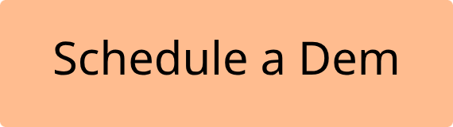

Ready to Transform Your Compliance Operations?
Deploy intelligent document analysis that saves time, reduces risk, and empowers your compliance team with instant access to critical regulatory information.
Immediate ROI
Risk Mitigation
See measurable time savings from day one of deployment
Never miss critical regulatory observations again
Future-Ready
Scalable architecture grows with your compliance needs

